Slide 1
Set Selection with Fairness and Diversity Constraints

Slide 2
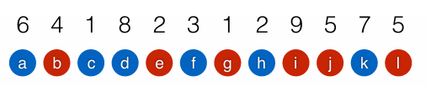
The basic problem setting
We have a set of items, each with associated category , id and utility score
From this set we have to select K items
The selected set must be subject to fairness and diversity constraints.
For example:

Slide 3
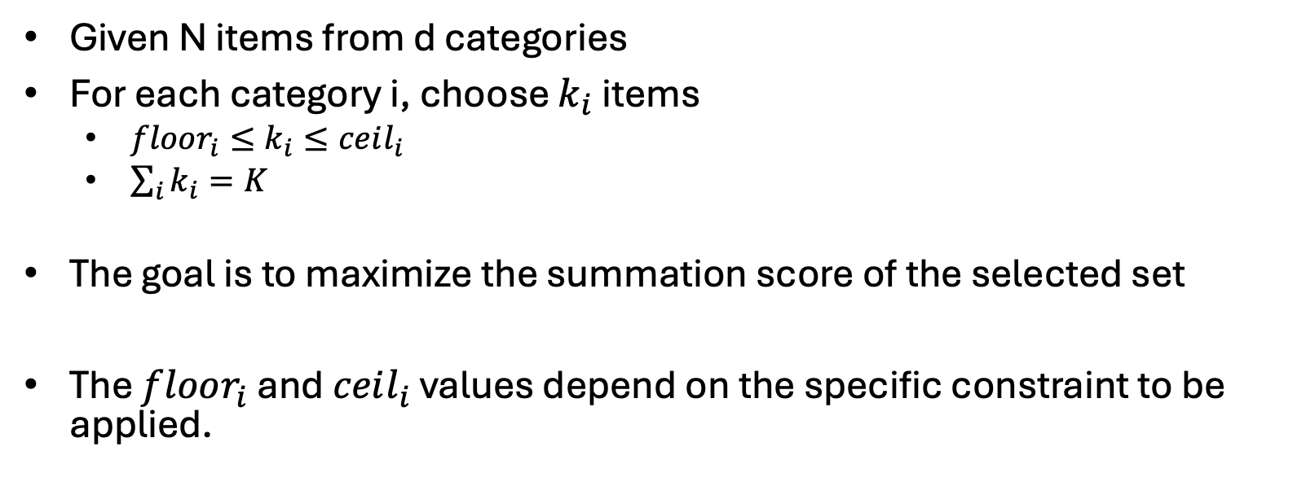
The overall problem definition
Given N items from d categories
For each category i, choose $k_{i}$ items
$floor_{i}≤k_{i}≤ceil_{i}$
$\sum_{i}{k_{i}}=K$
The goal is to maximize the summation score of the selected set
The $floor_{i}$ and $ceil_{i}$ values depend on the specific constraint to be applied.
Notes:
Given N items, each with an associated utility score and an identified sensitive attribute, for each value i of the sensitive attribute, choose $k_{i}$ items such that the summation utility of the selected set is maximized, subject to $floor_{i}≤k_{i}≤ceil_{i}$and subject to $\sum_{i}{k_{i}}=K$.
The $floor_{i}$ and $ceil_{i}$ values depend on the specific constraint to be applied.
These values are computed prior to the optimization problem, and are assumed to be given.

Slide 4
1) Static Algorithm - We have complete information about all items. - The items are sorted in descending order based on their score.
The paper presents three algorithms. We implemented two of them:
2) Online Algorithm - The items are unsorted. - We do not have information about future data. - For each item, we must decide immediately whether to select it or not.

Slide 5
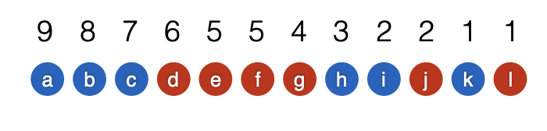
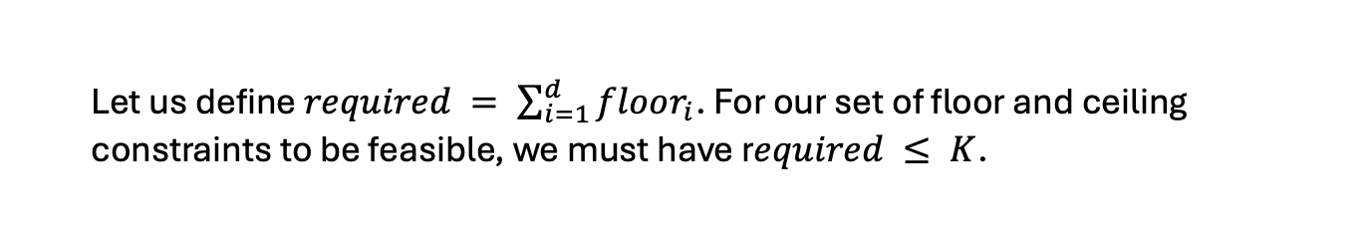
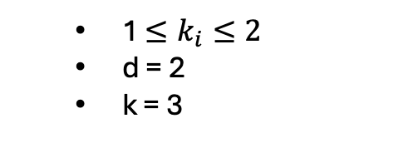
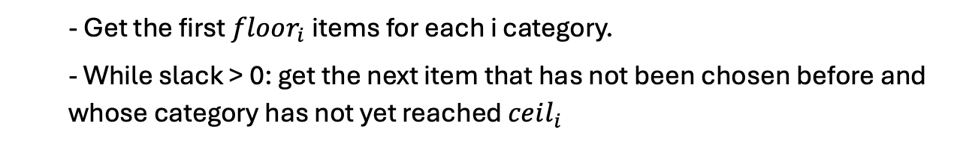
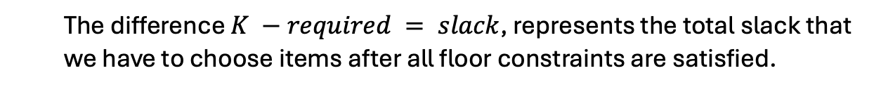
THE STATIC ALGORITHM
Main idea of the algorithm:
Let us define $required = \sum_{i=1}^{d}{floor_{i}}$. For our set of floor and ceiling constraints to be feasible, we must have r$equired ≤ K$.
1 $≤k_{i}≤2$
d = 2
k = 3
The difference $K −required = slack$, represents the total slack that we have to choose items after all floor constraints are satisfied.
- Get the first $floor_{i}$items for each i category.
- While slack > 0: get the next item that has not been chosen before and whose category has not yet reached $ceil_{i}$
We use this observation in Algorithm 1.
the algorithm accepts an item if the floor constraint of its category has not been met, or if the ceiling constraint of its category has not been met and some slack remains.
Algorithm 1 terminates once K items are selected.

Slide 6
THE STATIC ALGORITHM
Demo:

Slide 7
THE ONLINE ALGORITHM
Assumption:
The items appear one at a time, with decision to be made on the specific item instantaneously
we have to classify each individual item, as presented, into one of two buckets: “selected” or “not selected,” subject to the utility and diversity criteria in our problem statement, for the selected set
while the score of an item is unknown ahead of time, it is reasonable to assume that the number of items, both overall and in each category can be known ahead of time, because these properties are declared by the applicants.

Slide 8
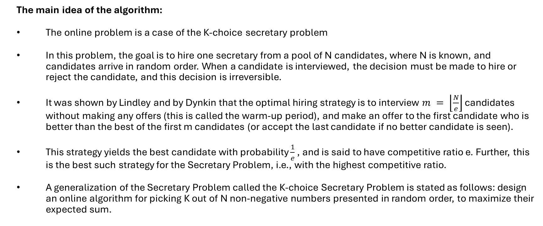
THE ONLINE ALGORITHM
The main idea of the algorithm:
The online problem is a case of the K-choice secretary problem
In this problem, the goal is to hire one secretary from a pool of N candidates, where N is known, and candidates arrive in random order. When a candidate is interviewed, the decision must be made to hire or reject the candidate, and this decision is irreversible.
It was shown by Lindley and by Dynkin that the optimal hiring strategy is to interview $m = \left\lfloor \frac{N}{e}\right\rfloor$ candidates without making any offers (this is called the warm-up period), and make an offer to the first candidate who is better than the best of the first m candidates (or accept the last candidate if no better candidate is seen).
This strategy yields the best candidate with probability $\frac{1}{e}$ , and is said to have competitive ratio e. Further, this is the best such strategy for the Secretary Problem, i.e., with the highest competitive ratio.
A generalization of the Secretary Problem called the K-choice Secretary Problem is stated as follows: design an online algorithm for picking K out of N non-negative numbers presented in random order, to maximize their expected sum.
Notes:
The main idea of the algorithm:
To explain the algorithm for this problem, we first need to briefly explain the secretary problem.
In this problem, the goal is to hire one secretary from a pool of N candidates, where N is known, and candidates arrive in random order. When a candidate is interviewed, the decision must be made to hire or reject the candidate, and this decision is irreversible.
It was shown by Lindley and by Dynkin that the optimal hiring strategy is to interview $m = \left\lfloor \frac{N}{e}\right\rfloor$ candidates without making any offers (this is called the warm-up period), and make an offer to the first candidate who is better than the best of the first m candidates (or accept the last candidate if no better candidate is seen).
This strategy yields the best candidate with probability $\frac{1}{e}$ , and is said to have competitive ratio e. Further, this is the best such strategy for the Secretary Problem, i.e., with the highest competitive ratio.
A generalization of the Secretary Problem called the K-choice Secretary Problem is stated as follows: design an online algorithm for picking K out of N non-negative numbers presented in random order, to maximize their expected sum.
While a straightforward extension of the Secretary Problem is natural here (with the same length of warm-up, $\left\lfloor \frac{N}{e}\right\rfloor$, remembering the scores of the K highest-scoring candidates), the exact optimal competitive ratio for this problem is not known for K > 1.
This quantity is known to lie between $1 +c\sqrt{k} and 1 +C\sqrt{k}$ for some pair of constants $c < C$.
The basic idea of this algorithm is to solve d K-choice Secretary Problems in parallel, one for each category, to satisfy the per-category floor constraints.
But that in itself is not enough: we also have to run a category-insensitive K-choice Secretary algorithm to select the remaining items, subject to ceiling constraints.
Algorithm 2 relies on the estimates of the number of items per category in the stream ($n_{i}$ represents the estimate of the number of items from category i), and guarantees that diversity constraints are met if these estimates are accurate.
The algorithm uses a MinHeap data structure to keep track of the top-K elements seen thus far. We need one for each category (denoted $T_{i}$ and initialized on line 6 with capacity $floor_{i}$), and an additional one for the extra elements after the floor constraints have been met (denoted T and initialized on line 10 with capacity slack).
Each per-category heap $T_{i}$ stores the best $floor_{i}$ scores seen among the first $r_{i}$ items of category i. If $floor_{i} > r_{i}$, then $T_{i}$ will store the first $floor_{i}$ elements observed, together with $floor_{i} −r_{i}$ elements of value − 1.
Heap T is initialized similarly, storing the best slack scores seen among the first $r = \left\lfloor \frac{N}{e}\right\rfloor$ items, irrespective of category.
During the warm-up period, an item x is not accepted (not added to L) irrespective of its score, but rather is offered to the relevant per-category heap or to the category independent heap.
Note that the same item x may be offered to its per-category heap and to the category-independent heap during warm-up.
An item of category i is added to the output after the warm-up period if $floor_{i}$ is not yet satisfied and either
the item has a sufficiently high score
we are at the end of the stream for category i (line 19).
The latter condition is evaluated by comparing the number of items remaining in the stream (ni −mi) to the number of items still required for i $(floor_{i} −k_{i})$.
An item is also added to the output if its score is sufficiently high according to the category-independent estimate and there is sufficient slack to meet all outstanding floor constraints.
Finally, an item is added to the output if it is feasible: accepting it would not violate the ceiling constraint for its category, and if exactly $K − |L|$ feasible items remain in the input.
We compute the number of feasible items as a sum of $n_{j} −m_{j}$ (the number of items that remain on the stream in category j) over all feasible categories (those in which $ceil_{j} − k_{j} > 0$).

Slide 9
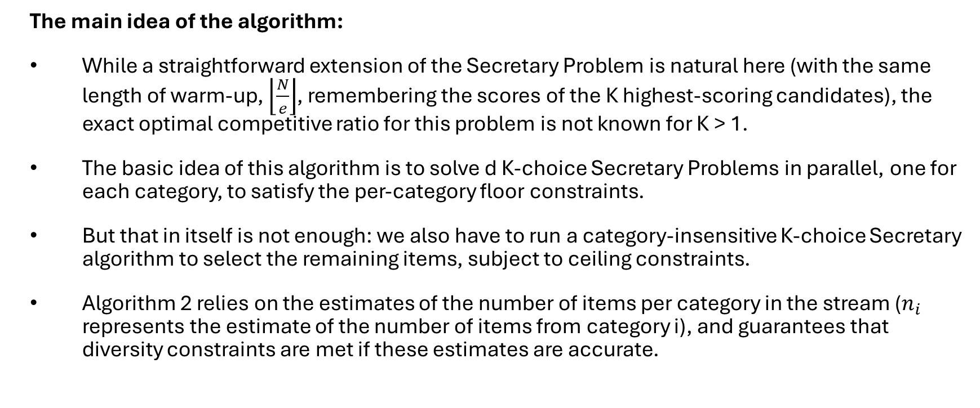
THE ONLINE ALGORITHM
The main idea of the algorithm:
While a straightforward extension of the Secretary Problem is natural here (with the same length of warm-up, $\left\lfloor \frac{N}{e}\right\rfloor$, remembering the scores of the K highest-scoring candidates), the exact optimal competitive ratio for this problem is not known for K > 1.
The basic idea of this algorithm is to solve d K-choice Secretary Problems in parallel, one for each category, to satisfy the per-category floor constraints.
But that in itself is not enough: we also have to run a category-insensitive K-choice Secretary algorithm to select the remaining items, subject to ceiling constraints.
Algorithm 2 relies on the estimates of the number of items per category in the stream ($n_{i}$ represents the estimate of the number of items from category i), and guarantees that diversity constraints are met if these estimates are accurate.
Notes:
The main idea of the algorithm:
To explain the algorithm for this problem, we first need to briefly explain the secretary problem.
In this problem, the goal is to hire one secretary from a pool of N candidates, where N is known, and candidates arrive in random order. When a candidate is interviewed, the decision must be made to hire or reject the candidate, and this decision is irreversible.
It was shown by Lindley and by Dynkin that the optimal hiring strategy is to interview $m = \left\lfloor \frac{N}{e}\right\rfloor$ candidates without making any offers (this is called the warm-up period), and make an offer to the first candidate who is better than the best of the first m candidates (or accept the last candidate if no better candidate is seen).
This strategy yields the best candidate with probability $\frac{1}{e}$ , and is said to have competitive ratio e. Further, this is the best such strategy for the Secretary Problem, i.e., with the highest competitive ratio.
A generalization of the Secretary Problem called the K-choice Secretary Problem is stated as follows: design an online algorithm for picking K out of N non-negative numbers presented in random order, to maximize their expected sum.
While a straightforward extension of the Secretary Problem is natural here (with the same length of warm-up, $\left\lfloor \frac{N}{e}\right\rfloor$, remembering the scores of the K highest-scoring candidates), the exact optimal competitive ratio for this problem is not known for K > 1.
This quantity is known to lie between $1 +c\sqrt{k} and 1 +C\sqrt{k}$ for some pair of constants $c < C$.
The basic idea of this algorithm is to solve d K-choice Secretary Problems in parallel, one for each category, to satisfy the per-category floor constraints.
But that in itself is not enough: we also have to run a category-insensitive K-choice Secretary algorithm to select the remaining items, subject to ceiling constraints.
Algorithm 2 relies on the estimates of the number of items per category in the stream ($n_{i}$ represents the estimate of the number of items from category i), and guarantees that diversity constraints are met if these estimates are accurate.
The algorithm uses a MinHeap data structure to keep track of the top-K elements seen thus far. We need one for each category (denoted $T_{i}$ and initialized on line 6 with capacity $floor_{i}$), and an additional one for the extra elements after the floor constraints have been met (denoted T and initialized on line 10 with capacity slack).
Each per-category heap $T_{i}$ stores the best $floor_{i}$ scores seen among the first $r_{i}$ items of category i. If $floor_{i} > r_{i}$, then $T_{i}$ will store the first $floor_{i}$ elements observed, together with $floor_{i} −r_{i}$ elements of value − 1.
Heap T is initialized similarly, storing the best slack scores seen among the first $r = \left\lfloor \frac{N}{e}\right\rfloor$ items, irrespective of category.
During the warm-up period, an item x is not accepted (not added to L) irrespective of its score, but rather is offered to the relevant per-category heap or to the category independent heap.
Note that the same item x may be offered to its per-category heap and to the category-independent heap during warm-up.
An item of category i is added to the output after the warm-up period if $floor_{i}$ is not yet satisfied and either
the item has a sufficiently high score
we are at the end of the stream for category i (line 19).
The latter condition is evaluated by comparing the number of items remaining in the stream (ni −mi) to the number of items still required for i $(floor_{i} −k_{i})$.
An item is also added to the output if its score is sufficiently high according to the category-independent estimate and there is sufficient slack to meet all outstanding floor constraints.
Finally, an item is added to the output if it is feasible: accepting it would not violate the ceiling constraint for its category, and if exactly $K − |L|$ feasible items remain in the input.
We compute the number of feasible items as a sum of $n_{j} −m_{j}$ (the number of items that remain on the stream in category j) over all feasible categories (those in which $ceil_{j} − k_{j} > 0$).

Slide 10
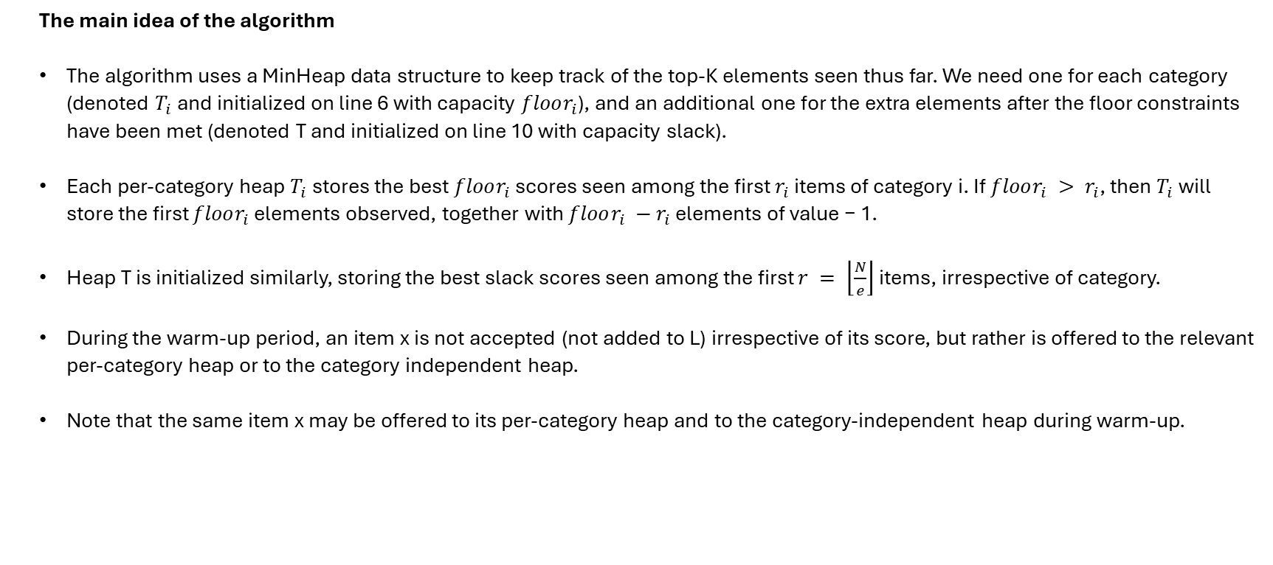
THE ONLINE ALGORITHM
The main idea of the algorithm
The algorithm uses a MinHeap data structure to keep track of the top-K elements seen thus far. We need one for each category (denoted $T_{i}$ and initialized on line 6 with capacity $floor_{i}$), and an additional one for the extra elements after the floor constraints have been met (denoted T and initialized on line 10 with capacity slack).
Each per-category heap $T_{i}$ stores the best $floor_{i}$ scores seen among the first $r_{i}$ items of category i. If $floor_{i} > r_{i}$, then $T_{i}$ will store the first $floor_{i}$ elements observed, together with $floor_{i} −r_{i}$ elements of value − 1.
Heap T is initialized similarly, storing the best slack scores seen among the first $r = \left\lfloor \frac{N}{e}\right\rfloor$ items, irrespective of category.
During the warm-up period, an item x is not accepted (not added to L) irrespective of its score, but rather is offered to the relevant per-category heap or to the category independent heap.
Note that the same item x may be offered to its per-category heap and to the category-independent heap during warm-up.
Notes:
The main idea of the algorithm:
To explain the algorithm for this problem, we first need to briefly explain the secretary problem.
In this problem, the goal is to hire one secretary from a pool of N candidates, where N is known, and candidates arrive in random order. When a candidate is interviewed, the decision must be made to hire or reject the candidate, and this decision is irreversible.
It was shown by Lindley and by Dynkin that the optimal hiring strategy is to interview $m = \left\lfloor \frac{N}{e}\right\rfloor$ candidates without making any offers (this is called the warm-up period), and make an offer to the first candidate who is better than the best of the first m candidates (or accept the last candidate if no better candidate is seen).
This strategy yields the best candidate with probability $\frac{1}{e}$ , and is said to have competitive ratio e. Further, this is the best such strategy for the Secretary Problem, i.e., with the highest competitive ratio.
A generalization of the Secretary Problem called the K-choice Secretary Problem is stated as follows: design an online algorithm for picking K out of N non-negative numbers presented in random order, to maximize their expected sum.
While a straightforward extension of the Secretary Problem is natural here (with the same length of warm-up, $\left\lfloor \frac{N}{e}\right\rfloor$, remembering the scores of the K highest-scoring candidates), the exact optimal competitive ratio for this problem is not known for K > 1.
This quantity is known to lie between $1 +c\sqrt{k} and 1 +C\sqrt{k}$ for some pair of constants $c < C$.
The basic idea of this algorithm is to solve d K-choice Secretary Problems in parallel, one for each category, to satisfy the per-category floor constraints.
But that in itself is not enough: we also have to run a category-insensitive K-choice Secretary algorithm to select the remaining items, subject to ceiling constraints.
Algorithm 2 relies on the estimates of the number of items per category in the stream ($n_{i}$ represents the estimate of the number of items from category i), and guarantees that diversity constraints are met if these estimates are accurate.
The algorithm uses a MinHeap data structure to keep track of the top-K elements seen thus far. We need one for each category (denoted $T_{i}$ and initialized on line 6 with capacity $floor_{i}$), and an additional one for the extra elements after the floor constraints have been met (denoted T and initialized on line 10 with capacity slack).
Each per-category heap $T_{i}$ stores the best $floor_{i}$ scores seen among the first $r_{i}$ items of category i. If $floor_{i} > r_{i}$, then $T_{i}$ will store the first $floor_{i}$ elements observed, together with $floor_{i} −r_{i}$ elements of value − 1.
Heap T is initialized similarly, storing the best slack scores seen among the first $r = \left\lfloor \frac{N}{e}\right\rfloor$ items, irrespective of category.
During the warm-up period, an item x is not accepted (not added to L) irrespective of its score, but rather is offered to the relevant per-category heap or to the category independent heap.
Note that the same item x may be offered to its per-category heap and to the category-independent heap during warm-up.
An item of category i is added to the output after the warm-up period if $floor_{i}$ is not yet satisfied and either
the item has a sufficiently high score
we are at the end of the stream for category i (line 19).
The latter condition is evaluated by comparing the number of items remaining in the stream (ni −mi) to the number of items still required for i $(floor_{i} −k_{i})$.
An item is also added to the output if its score is sufficiently high according to the category-independent estimate and there is sufficient slack to meet all outstanding floor constraints.
Finally, an item is added to the output if it is feasible: accepting it would not violate the ceiling constraint for its category, and if exactly $K − |L|$ feasible items remain in the input.
We compute the number of feasible items as a sum of $n_{j} −m_{j}$ (the number of items that remain on the stream in category j) over all feasible categories (those in which $ceil_{j} − k_{j} > 0$).

Slide 11
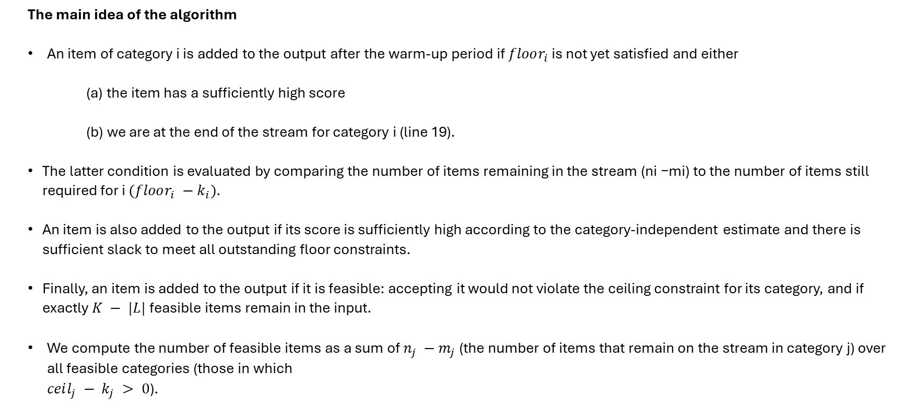
THE ONLINE ALGORITHM
The main idea of the algorithm
An item of category i is added to the output after the warm-up period if $floor_{i}$ is not yet satisfied and either
(a) the item has a sufficiently high score
(b) we are at the end of the stream for category i (line 19).
The latter condition is evaluated by comparing the number of items remaining in the stream (ni −mi) to the number of items still required for i $(floor_{i} −k_{i})$.
An item is also added to the output if its score is sufficiently high according to the category-independent estimate and there is sufficient slack to meet all outstanding floor constraints.
Finally, an item is added to the output if it is feasible: accepting it would not violate the ceiling constraint for its category, and if exactly $K − |L|$ feasible items remain in the input.
We compute the number of feasible items as a sum of $n_{j} −m_{j}$ (the number of items that remain on the stream in category j) over all feasible categories (those in which $ceil_{j} − k_{j} > 0$).
Notes:
The main idea of the algorithm:
To explain the algorithm for this problem, we first need to briefly explain the secretary problem.
In this problem, the goal is to hire one secretary from a pool of N candidates, where N is known, and candidates arrive in random order. When a candidate is interviewed, the decision must be made to hire or reject the candidate, and this decision is irreversible.
It was shown by Lindley and by Dynkin that the optimal hiring strategy is to interview $m = \left\lfloor \frac{N}{e}\right\rfloor$ candidates without making any offers (this is called the warm-up period), and make an offer to the first candidate who is better than the best of the first m candidates (or accept the last candidate if no better candidate is seen).
This strategy yields the best candidate with probability $\frac{1}{e}$ , and is said to have competitive ratio e. Further, this is the best such strategy for the Secretary Problem, i.e., with the highest competitive ratio.
A generalization of the Secretary Problem called the K-choice Secretary Problem is stated as follows: design an online algorithm for picking K out of N non-negative numbers presented in random order, to maximize their expected sum.
While a straightforward extension of the Secretary Problem is natural here (with the same length of warm-up, $\left\lfloor \frac{N}{e}\right\rfloor$, remembering the scores of the K highest-scoring candidates), the exact optimal competitive ratio for this problem is not known for K > 1.
This quantity is known to lie between $1 +c\sqrt{k} and 1 +C\sqrt{k}$ for some pair of constants $c < C$.
The basic idea of this algorithm is to solve d K-choice Secretary Problems in parallel, one for each category, to satisfy the per-category floor constraints.
But that in itself is not enough: we also have to run a category-insensitive K-choice Secretary algorithm to select the remaining items, subject to ceiling constraints.
Algorithm 2 relies on the estimates of the number of items per category in the stream ($n_{i}$ represents the estimate of the number of items from category i), and guarantees that diversity constraints are met if these estimates are accurate.
The algorithm uses a MinHeap data structure to keep track of the top-K elements seen thus far. We need one for each category (denoted $T_{i}$ and initialized on line 6 with capacity $floor_{i}$), and an additional one for the extra elements after the floor constraints have been met (denoted T and initialized on line 10 with capacity slack).
Each per-category heap $T_{i}$ stores the best $floor_{i}$ scores seen among the first $r_{i}$ items of category i. If $floor_{i} > r_{i}$, then $T_{i}$ will store the first $floor_{i}$ elements observed, together with $floor_{i} −r_{i}$ elements of value − 1.
Heap T is initialized similarly, storing the best slack scores seen among the first $r = \left\lfloor \frac{N}{e}\right\rfloor$ items, irrespective of category.
During the warm-up period, an item x is not accepted (not added to L) irrespective of its score, but rather is offered to the relevant per-category heap or to the category independent heap.
Note that the same item x may be offered to its per-category heap and to the category-independent heap during warm-up.
An item of category i is added to the output after the warm-up period if $floor_{i}$ is not yet satisfied and either
the item has a sufficiently high score
we are at the end of the stream for category i (line 19).
The latter condition is evaluated by comparing the number of items remaining in the stream (ni −mi) to the number of items still required for i $(floor_{i} −k_{i})$.
An item is also added to the output if its score is sufficiently high according to the category-independent estimate and there is sufficient slack to meet all outstanding floor constraints.
Finally, an item is added to the output if it is feasible: accepting it would not violate the ceiling constraint for its category, and if exactly $K − |L|$ feasible items remain in the input.
We compute the number of feasible items as a sum of $n_{j} −m_{j}$ (the number of items that remain on the stream in category j) over all feasible categories (those in which $ceil_{j} − k_{j} > 0$).

Slide 12
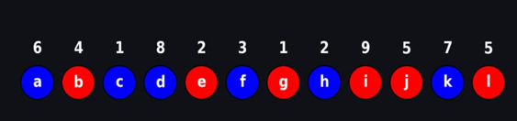
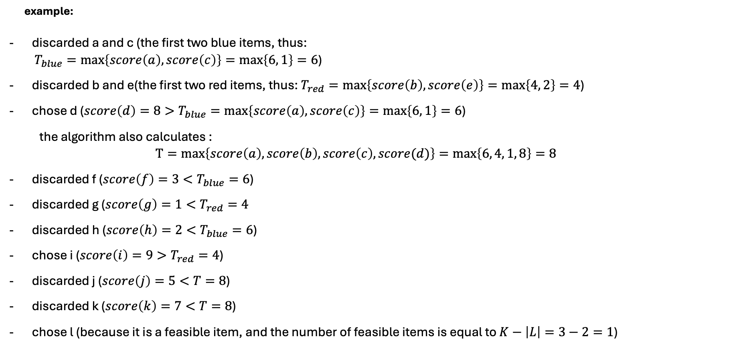
THE ONLINE ALGORITHM
example:
discarded a and c (the first two blue items, thus: $T_{blue}=\max\left\{score\left(a\right), score\left(c\right)\right\}=\max\left\{6, 1\right\}=6$)
discarded b and e(the first two red items, thus: $T_{red}=\max\left\{score\left(b\right), score\left(e\right)\right\}=\max\left\{4, 2\right\}=4$)
chose d ($score\left(d\right)=8>T_{blue}=\max\left\{score\left(a\right), score\left(c\right)\right\}=\max\left\{6, 1\right\}=6$)
the algorithm also calculates : $$T=max\left\{score\left(a\right), score\left(b\right), score\left(c\right), score(d)\right\}=\max\left\{6, 4, 1, 8\right\}=8$$
discarded f ($score\left(f\right)=3<T_{blue}=6$)
discarded g ($score\left(g\right)=1<T_{red}=4$
discarded h ($score\left(h\right)=2<T_{blue}=6$)
chose i ($score\left(i\right)=9>T_{red}=4$)
discarded j ($score\left(j\right)=5<T=8$)
discarded k ($score\left(k\right)=7<T=8$)
chose l (because it is a feasible item, and the number of feasible items is equal to $K−\left|L\right|=3−2=1$)
Notes:
The algorithm first discards $r_{i}=\left\lfloor \frac{n_{i}}{e}\right\rfloor =2$ items from every category, then fills the $floor_{i}$ constraints by picking the values higher than the maximum of the discarded items of each categories(the maximum of the discarded items in each each category are stored in $T_{red} and T_{blue}$), then the algorithm finds the maximum between the first $r=\frac{N}{e}=4$items (the value of the maximum between the first r=4 values is stored in T), and only accepts values which are above it.which is why the algorithm:

Slide 13
THE ONLINE ALGORITHM
Demo:

Slide 14
THE ONLINE ALGORITHM - Datasets
We ran our online algorithm on two datasets :
1) synthetic dataset
synthetic dataset that contains 400 items, with 200 items in category 0 and 200 items in category 1. The scores were randomly selected from a range of 1 to 1000.
2) Predict Test Scores of students dataset
We made use of the school_setting, gender, and posttest attributes.
The school_setting attribute has three different values: ['Urban', 'Suburban', 'Rural’].
The gender attribute has two values: ['Female', 'Male’].
Therefore, we considered every combination of these attributes (6 in total) as distinct categories for the algorithm.
The posttest score served as the score value for each item in our algorithm.

Slide 15
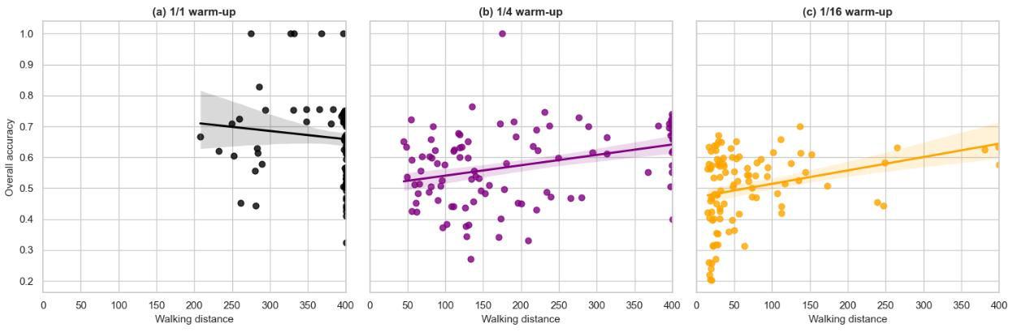
Impact of Walking Distance on Accuracy Across Different Warm-Up Factors
test_scores dataset
synthetic dataset

